Slide 1
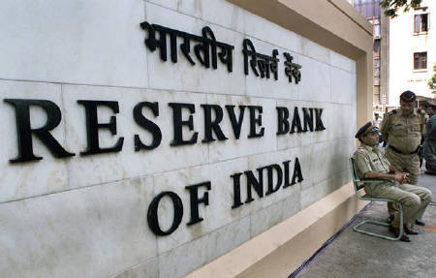
RESERVE BANK OF INDIA

Slide 2
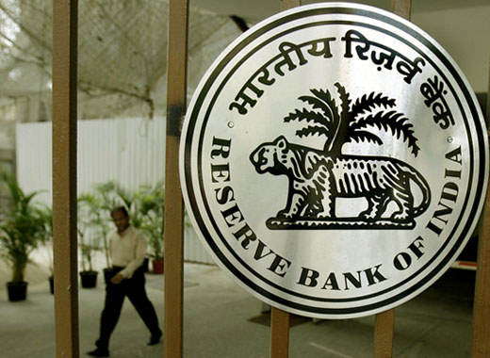
INTRODUCTION
It is the Central Bank of India Established on “1st April 1935” under the “RESERVE BANK OF INDIA ACT”.
Its head quarter is in Mumbai (Maharashtra). Its present governor is “DR. RAGHURAM RAJAN”.
It has “22 Regional Offices”, most of them in State capitals.

Slide 3
BRIEF HISTORY
It was set up on the recommendations of the “Hilton Young Commission”.
It was started as Share-Holders Bank with a paid up capital of 5 crores.
Initially it was located in Kolkata and moved to Mumbai in 1937.
Initially it was Privately Owned.
Since Nationalization in 1949, the Reserve Bank is fully owned by the Government of India.

Slide 4
PREAMBLE
The Preamble of the Reserve Bank of India describes the basic functions of the Reserve Bank as :-
“…To regulate the issue of Bank Notes and keeping of reserves with a view to securing monetary stability in India and generally to operate the currency and credit system of the country to its advantage."

Slide 5
Acts governing specific functions
Public Debt Act, 1944/Government Securities Act (Proposed): Governs government debt market.
Securities Contract (Regulation) Act,1956: Regulates government securities market.
Indian Coinage Act,1906:Governs currency and coins.
Foreign Exchange Regulation Act,1973/Foreign Exchange Management Act,1999: Governs trade and foreign exchange market.
"Payment and Settlement Systems Act, 2007: Provides for regulation and supervision of payment systems in India“.

Slide 6
Central board
The general superintendence and direction of the RBI is entrusted with the 21-members-
1. Central board Governor(currently Raghuram Rajan),
2.Four deputy governor, two ministry representative, ten government-nominated directors to represent important elements from India's economy, and four directors to represent local boards headquartered at Mumbai, Kolkata, Chennai and New Delhi.

Slide 7
Constitution
Official Directors
Full-time : Governor and not more than four Deputy Governors
Non-Official Directors
Nominated by Government: ten Directors from various fields and two government Officials
Others: four Directors - one each from four local boards

Slide 8
Each of these local boards consists of five members who represent regional interests, as well as the interests of co-operative and indigenous banks .The reserve bank’s affairs are governed by a central board of directors. The board is appointed by the Government of India in keeping with the Reserve Bank of India Act.

Slide 9
FUNCTIONS OF RBI
Issue of currency
Development role
Banker to government
Banker to bank
Role of RBI in inflation control
Formulate monetary policy
Manager of foreign reserve
Clearing house functions
Regulations of banking system

Slide 10
Issue of Currency
To ensure adequate quantity of supplies of currency notes and coins of good quality.
Issues new currency and destroys currency and coins not fit for circulation.
It has to keep in forms of gold and foreign securities as per statutory rules against notes & coins issued.
Developmental Role
To develop the quality of banking system in India.
Performs a wide range of promotional functions to support national objectives.
To establish financial institutions of national importance, for e.g: NABARD,IDBI etc.

Slide 11
Banker to the Government:
Performs all banking function for the central and the state governments and also acts as their banker excepting that of Jammu and Kashmir. It makes loans and advances to the States and local authorities. It acts as adviser to the Government on all monetary and banking matters.

Slide 12
Banker to banks:
  Maintains banking accounts of all scheduled banks.
  RBI also regulates the opening /installation of ATM Fresh currency notes for ATMs are supplied by RBI.
  RBI regulates the opening of branches by banks.
  It ensures that all the N.B.F.S follow the Know Your Customer guidelines.

Slide 13
The Reserve Bank of India also regulates the trade of gold. Currently 17 Indian banks are involved in the trade of gold in India.
RBI has invited applications from more banks for direct import of gold to curb illegal trade in gold and increase competition in the market.
Collection and publication of data.
It issues guidelines and directives for the commercial banks.

Slide 14
Role of RBI in inflation control
Inflation arises when the demand increases and there is a shortage of supply There are two policies in the hands of the RBI.
Monetary Policy: It includes the interest rates. When the bank increases the interest rates than there is reduction in the borrowers and people try to save more as the rate of interest has increased.
Fiscal Policy: It is related to direct taxes and government spending. When direct taxes increased and government spending increased than the disposable Income of the people reduces and hence the demand reduces.

Slide 15
Formulate monetary policy
Maintain price stability and ensuring adequate flow of credit in the economy.
It formulates implements and monitors the monetary policy.
Instruments: qualitative & quantitative.

Slide 16
Quantitative Measures
Quantitative Measures “BANK RATE” also called “Discount Rate”.
It also includes “Repo Rate”.
“Open Market Operations” buying and selling of government securities.
“Variable Reserve Ratio” it includes C.R.R and S.L.R
Qualitative Measures
1. Direct Action
2. Moral persuasion
3. Legislation
4. Publicity

Slide 17
BANK RATE
It’s the interest rate that is charged by a country’s central bank on loans and advances to control money supply in the economy and the banking sector.
This is typically done on a quarterly basis to control inflation and stabilize the country’s exchange rates.
A fluctuation in bank rates Triggers a Ripple-Effect as it impacts every sector of a country’s economy.
A change in bank rates affects customers as it influences Prime Interest Rates for personal loans.
The present bank rate is 9%

Slide 18
REPO RATE
whenever the banks have any shortage of funds they can borrow it from the central bank. Repo rate is the rate at which our banks borrow currency from the central bank.
A reduction in the repo rate will help banks to get Money at a cheaper rate.
When the repo rate increases borrowing from the central bank becomes more expensive.
In order to increse the liquidity in the market, the central bank does it.
The present repo rate is 8%

Slide 19
REVERSE REPO RATE
It’s the rate at which the banks park surplus funds with reserve bank.
While the Repo rate is the rate at which the banks borrow from the central bank.
It is mostly done , when there is surplus liquidity in the market by the central bank.
The present reverse repo rate is 7%

Slide 20
SLR ( Statutory Liquidity Ratio)
It is the amount a commercial bank needs to maintain in the form of cash, or gold or govt. approved securities (Bonds) before providing credit to its customers.
SLR rate is determined and maintained by the RBI (Reserve Bank of India) in order to control the expansion of bank credit.
The present SLR rate is 23%.

Slide 21
CRR (Cash Reserve Ratio)
Cash Reserve Ratio (CRR) is the amount of Cash(liquid cash like gold)that the banks have to keep with RBI.
This Ratio is basically to secure solvency of the bank and to drain out the excessive money from the banks.

Slide 22
QUALITATIVE MEASURES
1. Direct Action: The central bank may take direct action against commercial banks that violate the rules, orders or advice of the central bank. This punishment is very severe of a commercial bank.
2. Moral persuasion: It is another method by which central bank may get credit supply expanded or contracted. By moral pressure it may prohibit or dissuade commercial banks to deal in speculative business.

Slide 23
3. Legislation:
The central bank may also adopt necessary legislation for expanding or contracting credit money in the market.
4. Publicity:
The central bank may resort to massive advertising campaign in the news papers, magazines and journals depicting the poor economic conditions of the country suggesting commercial banks and other financial institutions to control credit either by expansion or by contraction.

Slide 24
Manager of Foreign Exchange
To facilitate external trade and payment and promote orderly development and maintenance of foreign exchange market in India.
It acts as a custodian and Manages the Foreign Exchange Management Act,(FEMA) 1999.
RBI buys and sells foreign currency to maintain the exchange rate of Indian Rupee v/s foreign currencies like the US Dollar, Euro, Pound and Japanese yen.

Slide 25
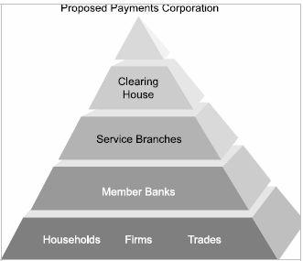
Clearing House Functions
The RBI operates clearing houses to settle banking transactions. The RBI manages 14 major clearing houses of the country situated in different major cities. The State Bank of India and its associates look after clearing houses function in other parts of the country as an agent of RBI.

Slide 26
conclusion
As we know RBI is an apex body and it regulates the flow of money in economy. Recently new governor appointed DR. Raghuram Rajan on 5th september. The current financial crisis of depreciation of rupee has been appreciated within 8 days by attracting foreign investors, by promoting ECBs, and by reducing ODI capital limits. Thus RBI is the hand of the king when the king is our Indian economy.

